Slide 1

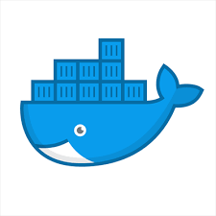
What are we going to see in this session?
Why Docker
What is Docker
Docker ecosystem
What is container
Difference between Container and VM
Lets understand how docker works
Docker Installation introduction
Docker Installation (windows/Mac & Linux)

Slide 2
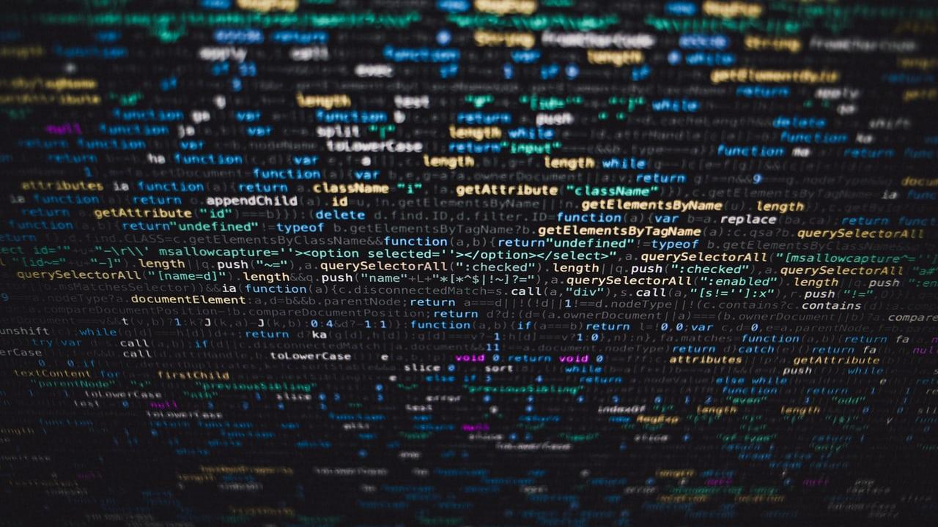
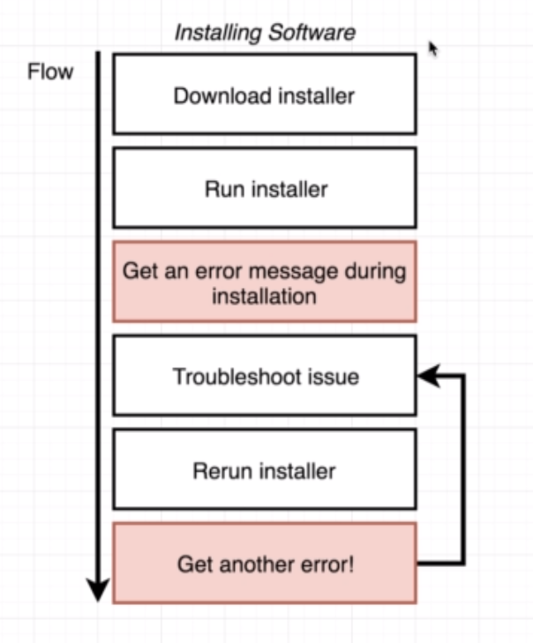
Why Docker ?
To understand docker, first lets try to understand simple scenario.
Software installation: Which everyone would have tried to install software in any machine at least once in your life before.
This is the flow how to install software in any machine.
Eventually, every one would have faced multiple issues while installation.
For instance,
Dependent software's not found [wget, curl, unzip, tar] to install.
You will be trying hard to fix any issues which is coming upon every time when you install software.
The is the core cause which Docker is trying to fix.
Docker wants to make it really easy and straight forward to install any software in computer. (On your laptop, VMs, Server or cloud instance)
In Nutshell, the real use case of Docker is to install and run software without worrying about setup or dependencies.

Slide 3
What is Docker ?
Docker is just a software which is used to perform operating system virtualization.
This is also know as containerization.
These containers are isolated from each other and bundled with their own application, tools, libraries and configuration files.
Though these containers are isolated it can communicate with each other through well-defined channels.
All these containers share the base operating system kernel thus its more lightweight then virtual machines.

Slide 4
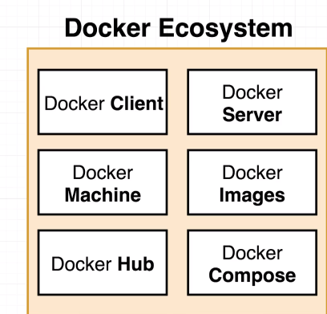
Docker Ecosystem ?
Anytime you see someone who refer docker in blog post, article or forum they might referring to many terminologies like [Docker images, Hub, Compose, build, client, server etc..]
However these are tools which comes together to form a platform or ecosystem to create and run something called containers.
Well your next question would be what is the container as we are speaking a lot about it ? Lets see about it in details.

Slide 5
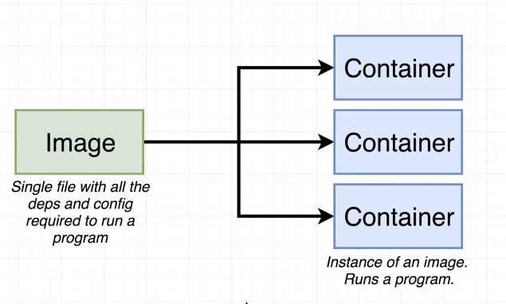
What is Container ?
As the image explains, you have an single file called image with all the dependencies and software installed and ready.
This single file is going to store in your local machine. At some point of time you can use this image to create some thing called container.
The container is an instance of an image, which is going to run your application.

Slide 6
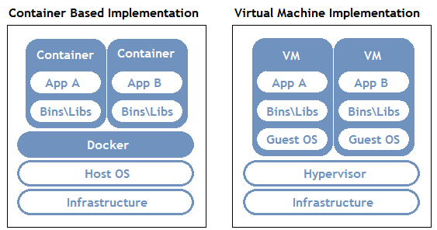
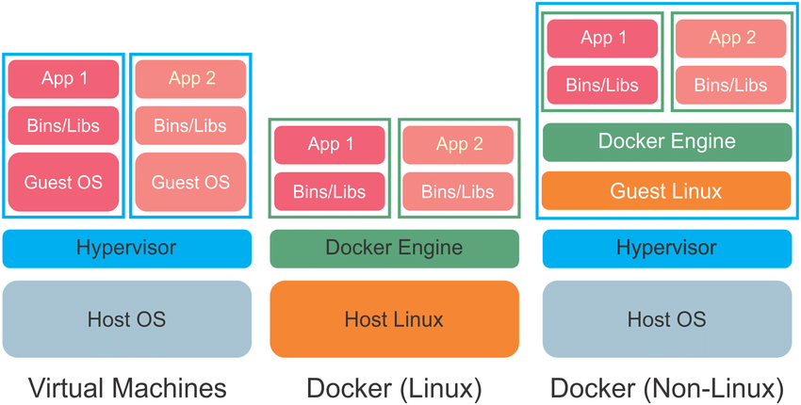
Difference between container & VM
Everyone might have this question in mind, well here is the explanation for it.

Slide 7
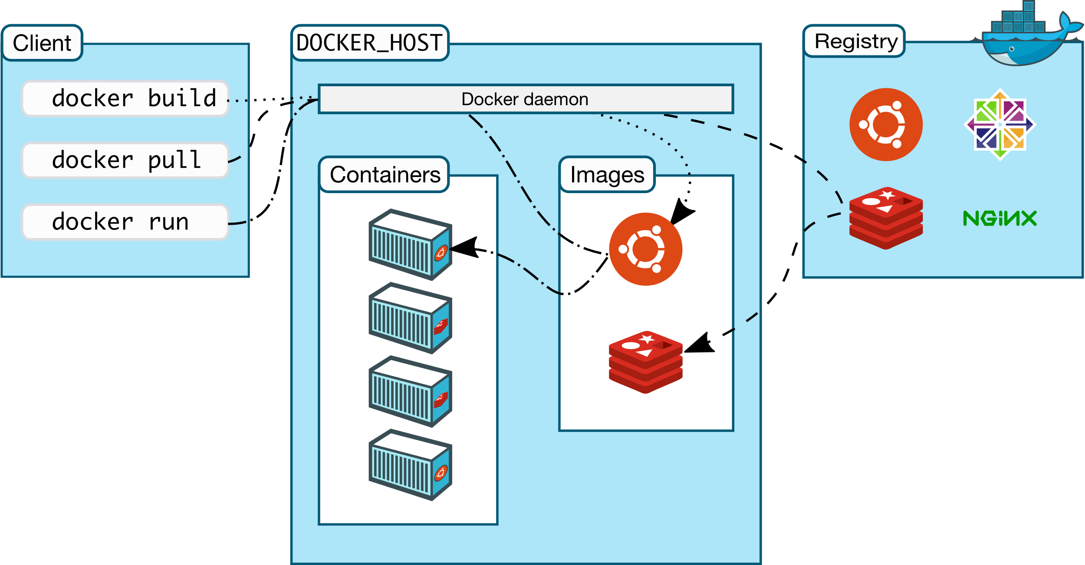
Let’s understand how docker works
Now you might have some idea about container & images. Lets try to put things together.

Slide 8
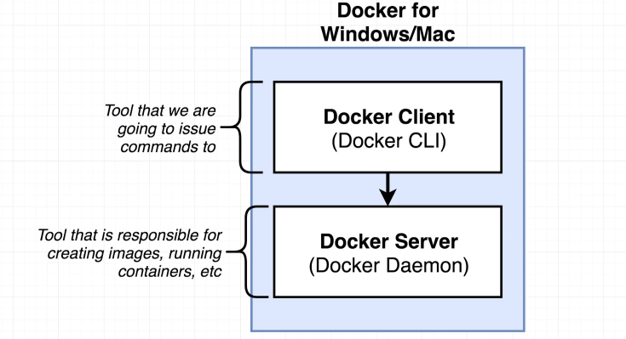
Docker installation introduction
So here is what we are going to do, we are going to install piece of software called docker in your machine (either windows, mac or Linux)
Inside docker application it is going to have 2 components.
Docker Client :
Which is going to help us interacting with Docker server through commands which we are providing from command line.
Docker Server :
This piece of components is really responsible to creating images
running and maintaining containers.
As mentioned, we are not going to interact with docker server directly all interactions will be taken through docker cli. Docker server demon is something which is doing things behind the scenes.

Slide 9
Docker installation (Windows/Mac/Linux)
How to install docker in your desktop.
https://www.docker.com/products/docker-desktop
Installation in Linux machines (Most often used in real time)
https://docs.docker.com/engine/install

Slide 10
End of this topic !
Any questions?

